Slide 1
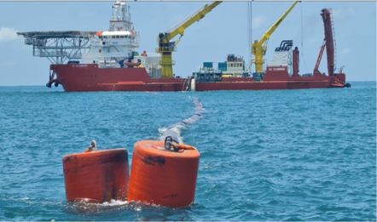
SPDC OPEX Cost Improvement
Eliminating Demurrage in SPDC Terminals
Sponsor: Mesh Maichibi
Asset Manager, West, SPDC Performance Unit

Slide 2

Agenda
01
Opening remarks
02
Demurrage 101
03
Performance
Sponsor: Mesh M.
What we need to know about demurrage.
Ben N.
Demurrage + Oil Loss claims 3year data/trend
Priscillia U.
04
Business Case
05
Ways of working
06
Closing remarks
Review business case, objectives, benefit…
Doro G-K
Agile approach
Alphonsus A.
Charge to team
Arthur O./Anny A.
SPDC

Slide 3
Let’s talk demurrage

Slide 4
CLAIMS AWARENESS SESSION
Overview
Ben Nzeh
Head Claims

Slide 5
1.0
INTRODUCTION & BACKGROUND
Cargo Claims fall into three categories:
Demurrage – well established process, claims being reimbursed on actual performance
Oil Loss – existing process between NNPC and SPDC/SNEPCo, not mature with NUPRC or NUIMS
Miscellaneous Claims (Or “Post Deal Expenses”, “PDE”) – no process

Slide 6
What is Demurrage
Demurrage is the amount of money paid as compensation to the owner of a vessel or the charterers for detaining the vessel beyond an agreed amount of time for loading and / or unloading cargo.
The agreed amount of time to berth and load a vessel before demurage is incurred is 36 hours with a minimum of 18 hours pro rated to the size of the vessel. The demurrage clock stops once loading hoses are disconnected.
Not all demurrage is punitive. There is what is called good demurrage. i.e. Incurring demurrage to ensure a vessel is waiting in the vicinity of the terminal to avoid shut ins due to tank tops. E.g. 1 days demurrage 70k v 5mln for 100kb production shut in.
Demurrage charges are calculated by using Average Freight Rate Assessment (AFRA) based on the Worldwide Tanker Nominal Freight scale but prorated to the size of the tanker.
Current Vessel rates per day: VLCC $68,598 SUEZ MAX $71,284

Slide 7
OIL LOSES
Oil loses may occur at many stages during the supply cycle of crude oil. With the prevailing high crude prices, claims due to cargo loss, have increased tremendously. Thus, more serious attention is presently given to measurement accuracy in Petroleum Industry, with a view to minimizing such cargo losses.
Cargo loss claim could either be a Quantity or Quality claim.
Overstated Bills of Lading (Quantity Claim)
Understated BS&W (Quality Claim)

Slide 8
POST DEAL CLAIMS
Miscellaneous Claims (Or “Post Deal Expenses”, “PDE”) include:
These are NOT addressed directly under existing JOA/PSC agreements but are valid costs and include:
Speed up costs: ships requested to arrive earlier than agreed laycan to avert production deferment/tanktops
Water disposal and detention costs if high water in cargo and require additional logistics for disposal
Costs associated with maintenance/line displacement operations at Terminals
Extraordinary claims eg detention costs at Forcados during recent outages

Slide 9
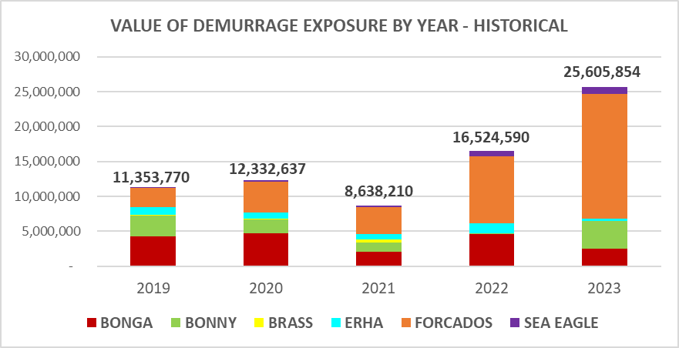
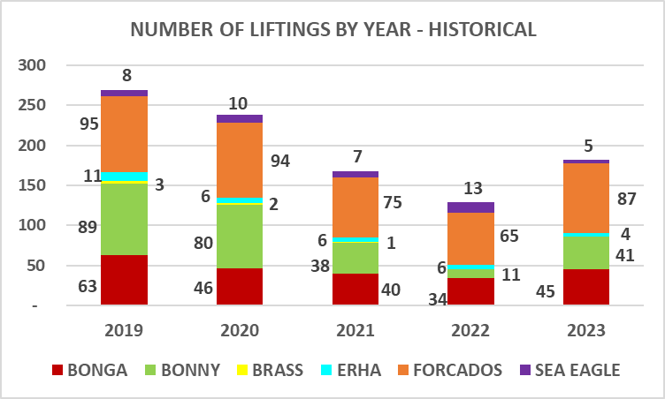
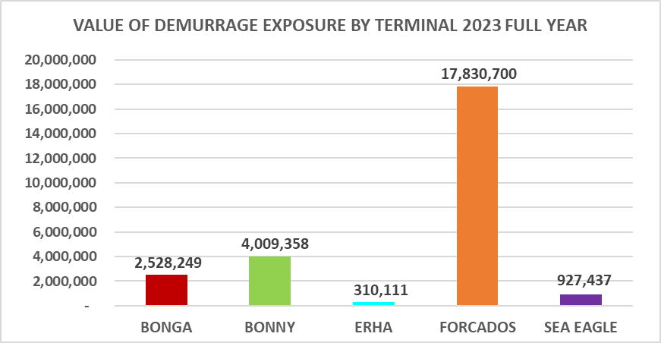
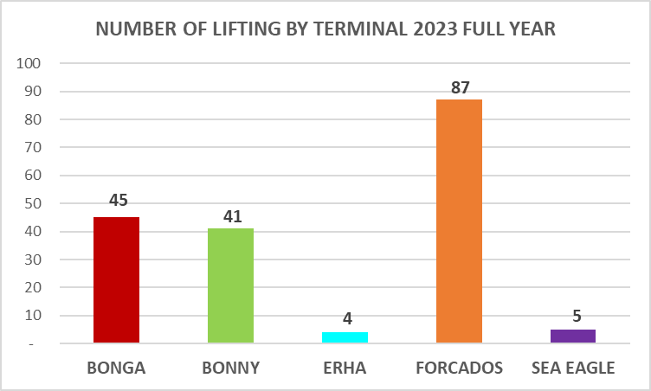
DEMURRAGE OVERVIEW: JANUARY – DECEMBER 2023

Slide 10
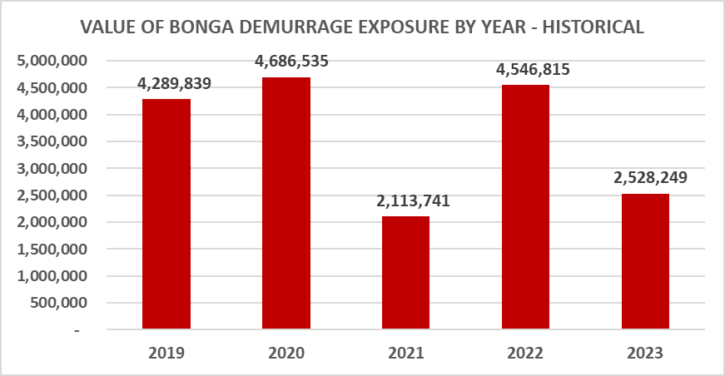
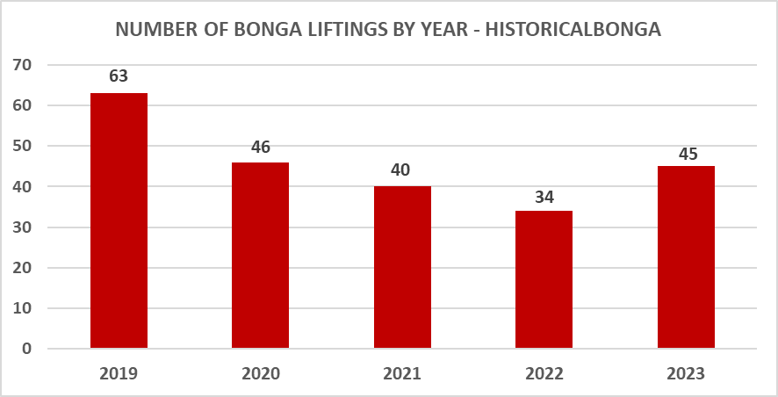
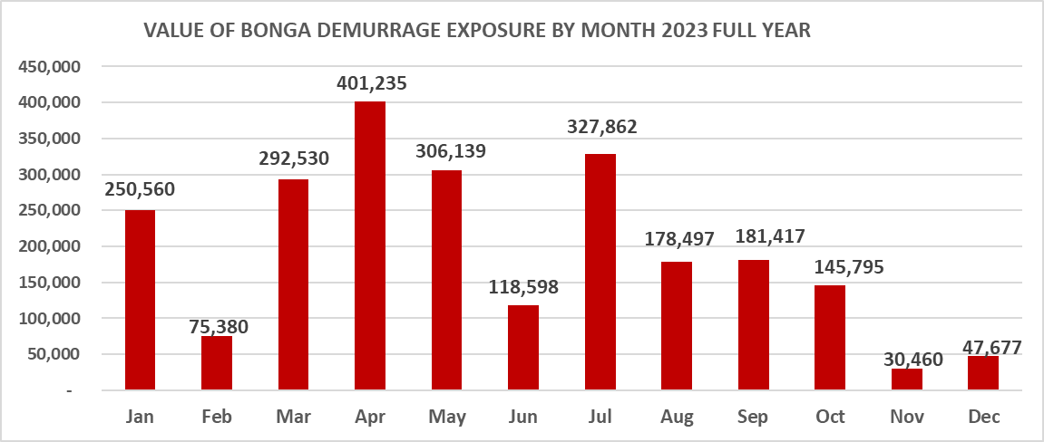
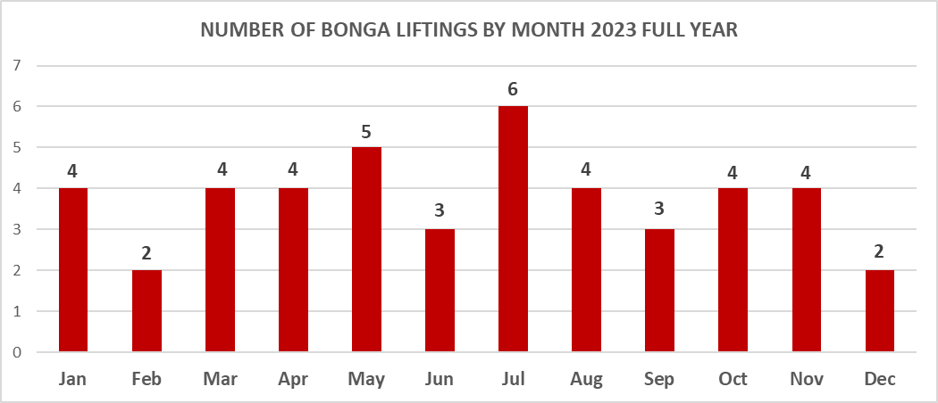
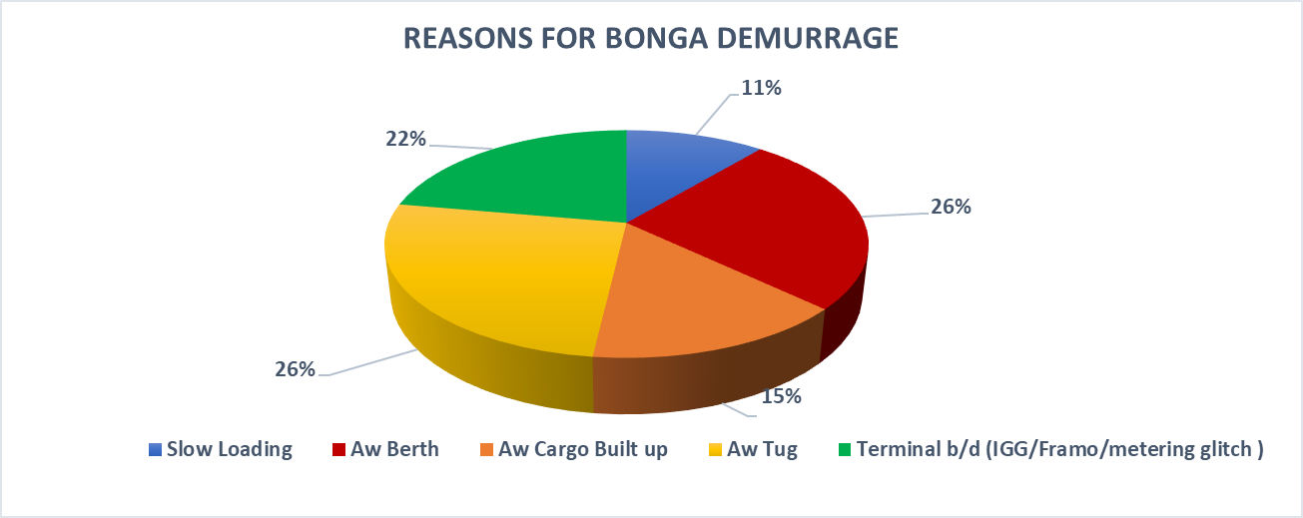
DEMURRAGE OVERVIEW - BONGA
Notes:
r

Slide 11
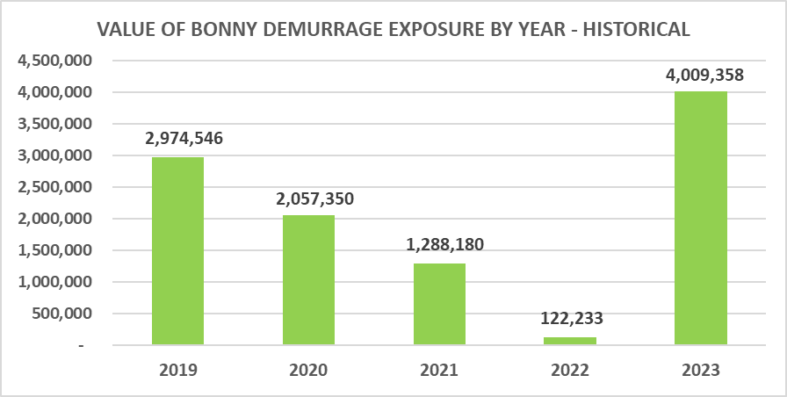
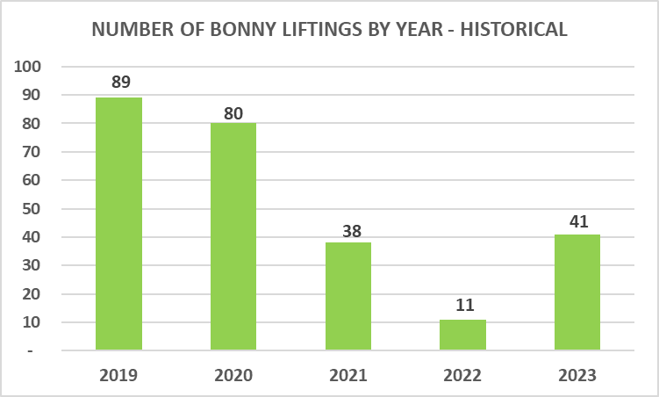
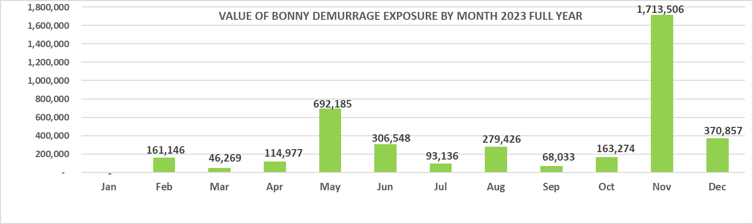
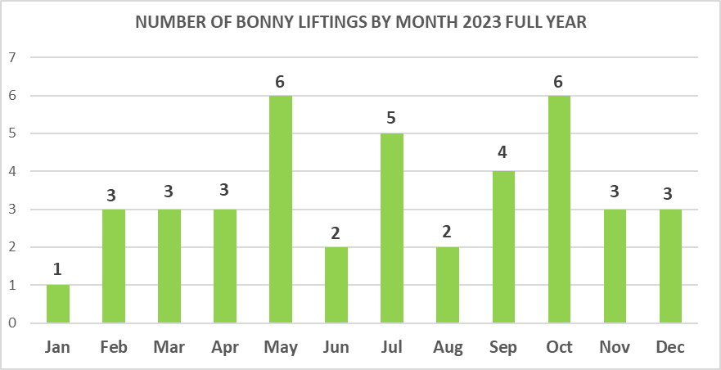
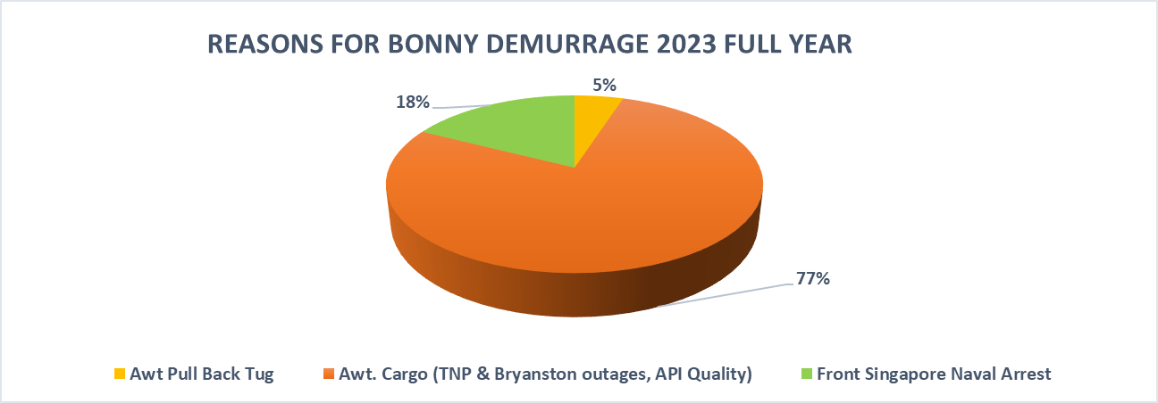
DEMURRAGE OVERVIEW - BONNY

Slide 12
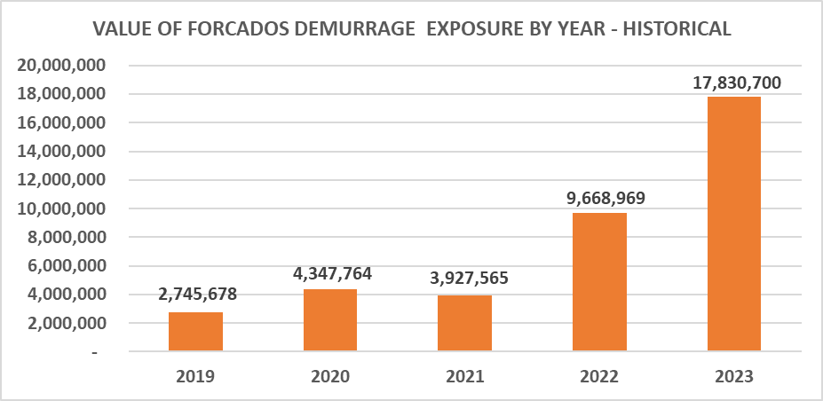
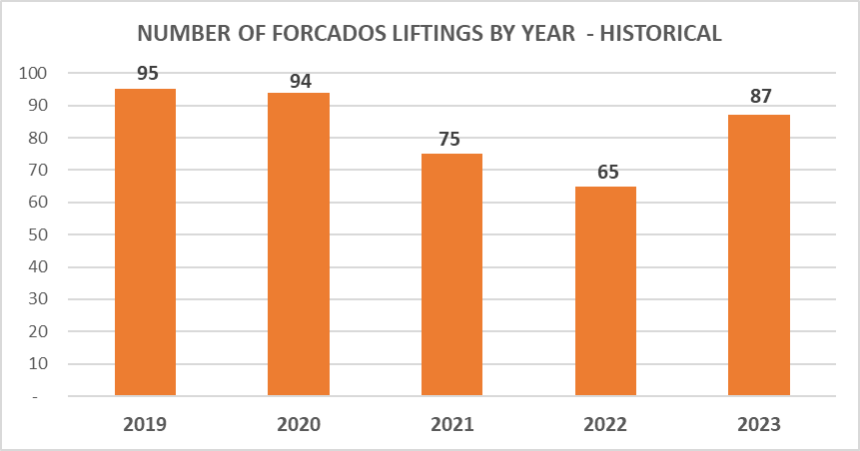
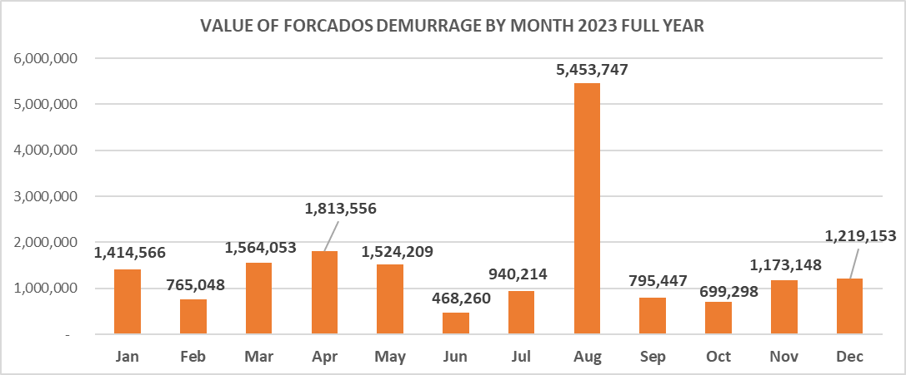
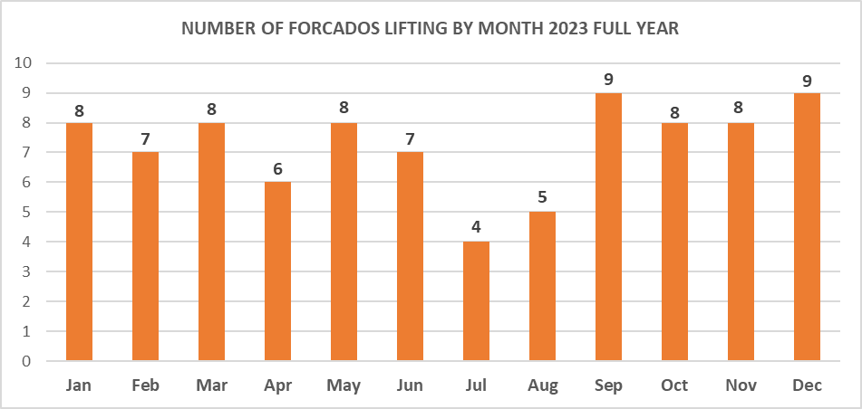
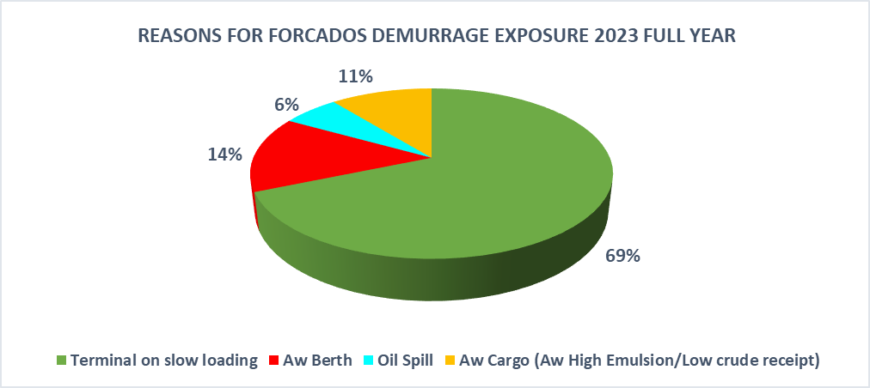
DEMURRAGE OVERVIEW - FORCADOS
Demurrage cause by frequency

Slide 13
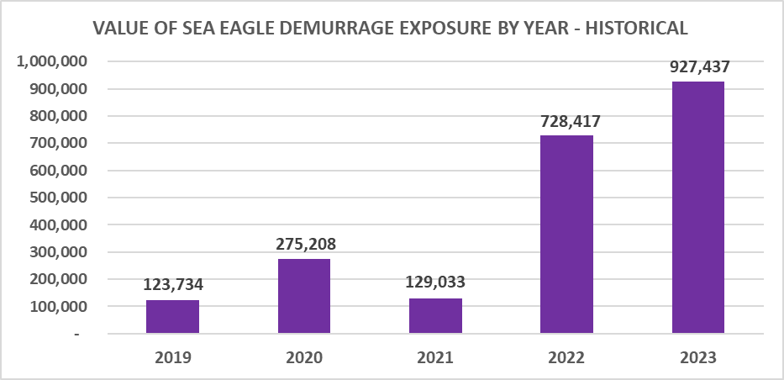
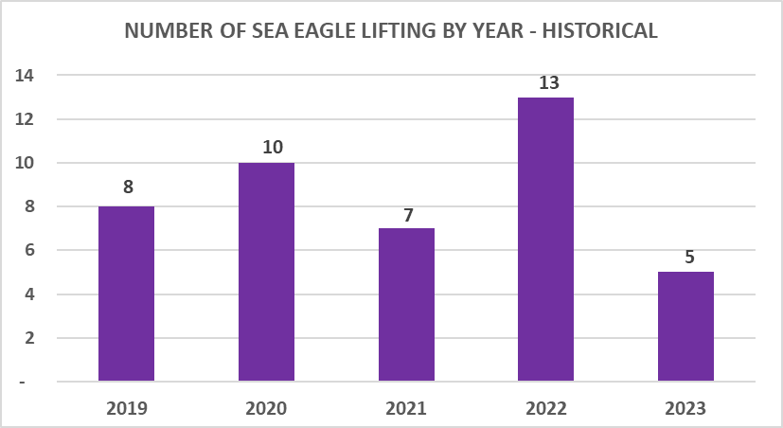
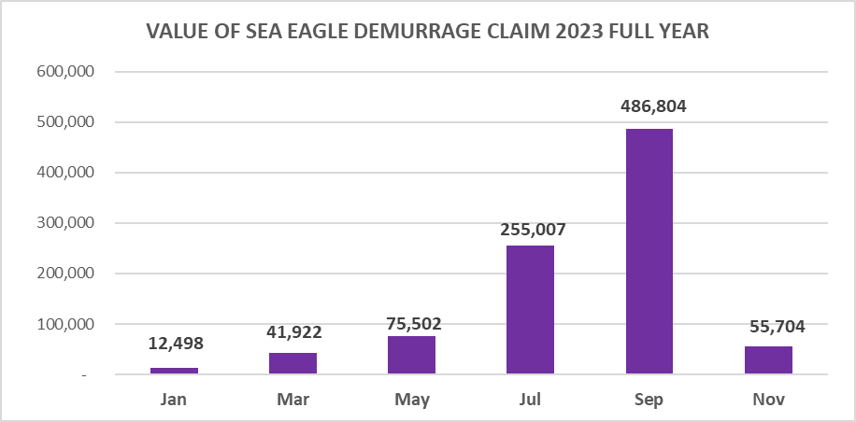
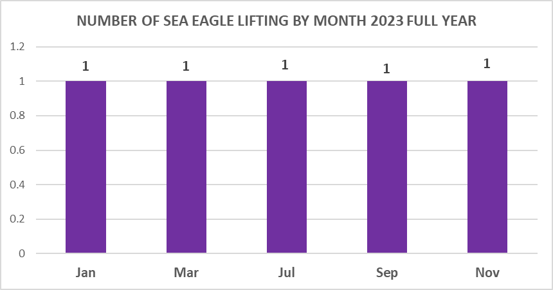
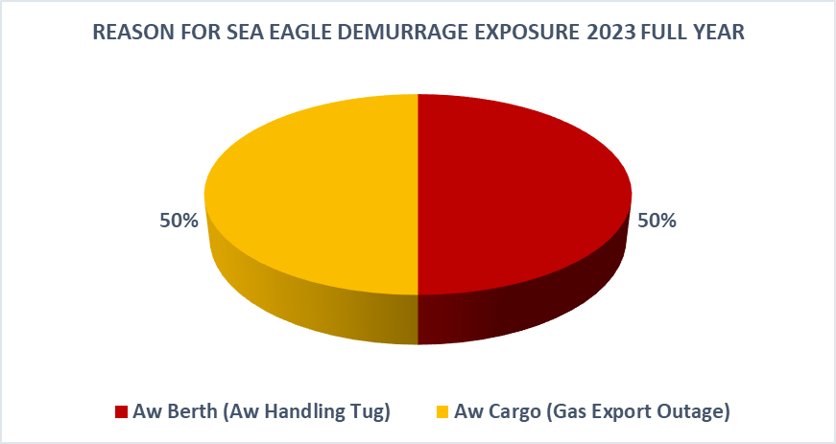
DEMURRAGE OVERVIEW – SEA EAGLE

Slide 14
2.0
OIL LOSS CLAIMS

Slide 15
OVERVIEW OF OPEN OIL LOSS CLAIM

Slide 16
Export claims 2022 and 2023

Slide 17
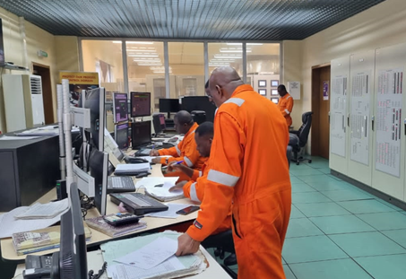
Initiative Title: Eliminating Demurrage in SPDC Terminals
Business Case
Objectives
Benefits
Target | Zero demurrage cost incurred
 |  |  | Production forecast stability
 |  | Enhanced tanker turnaround time
Current State | Baseline Performance
SPDC experienced increased value erosion from demurrage claims in the past four years. Total claims rose from ~$6.4m in 2020 to ~$23m in 2023 largely due to slower loading at Forcados Terminal caused by SPM integrity issues/outage and awaiting cargo in Bonny Terminal due to lower receipts from TNP. In line with the drive to improve cost competitiveness, an ambitious 2024 business plan was endorsed with a provision for demurrage capped at $7.2m With the restoration of FSPM1 and proven functionality of the Tri Catenary Mooring system, more focus and cross-functional integration is required to achieve and sustain “offtake ready everyday” across SPDC Terminals. Ambition is to incur ZERO demurrage claims charge in 2024.
Understand what it takes to deliver a ‘perfect’ offtake Close identified gaps/root causes that contribute to demurrage cost Implement a performance measurement and monitoring system to sustain improvement
Deliver ~$7m OPEX cost savings in 2024 Prevent > $20million/annum value erosion Lower unit operating cost for SPDC Export Terminals
Fig: Demurrage Reduction Staircase

Slide 18
Initiative Team
 | Team
 | Terminals | Arthur O. / Anny A. (Lead) Osita N./Florence O. Chris Ugochukwu Terminal Superintendents
 | Terminal Marine Ops | Edidiong A./Adetunji S. Aliyu M./Jerome U.
 | Shipping & Export | Michael D’Souza Kevwe Ofovwe Ben Nzeh
 | Terminal Marine Ops | Edidiong A./Adetunji S.
 | Finance | Priscillia Uwagboe/ Seun Ajayi
 | Transformation | Alphonsus Akaka Doro Garus-Kogi
Agile approach |  | Agile approach
Venue | Online – MS Teams
Ceremonies | Daily huddle – 10mins | YTT - Task level planning/commitment
Ceremonies | Focus sessions– 120mins/week | Frame the specific scope Data gathering – review of previous work and inflight improvement actions Root Cause analysis Solution planning Develop implementation plan(s)
 | Sprint review – 30mins Integrate with West Asset weekly cadence | Share progress of deliverables with Sponsor Get feedback/direction Discuss any impediments
 | Sprint retrospective – 10mins Integrate with daily huddle after weekly sprint review | A space for the team to reflect collectively How did we show up? Did we deliver on commitments? etc

